Slide 1
Data Warehousing and Data Mining
Unit 5
Mining Frequent Patterns

Slide 2
Frequent Pattern
Frequent pattern: a pattern (a set of items, subsequences, substructures, etc.) that occurs frequently in a data set
Eg:- In a transaction data set, milk and bread are frequent
Motivation: Finding inherent regularities in data
What products were often purchased together?— Beer and diapers?!
What are the subsequent purchases after buying a PC?
What kinds of DNA are sensitive to this new drug?
Can we automatically classify web documents?
Applications
Basket data analysis, cross-marketing, catalog design, sale campaign analysis, Web log (click stream) analysis, and DNA sequence analysis.

Slide 3
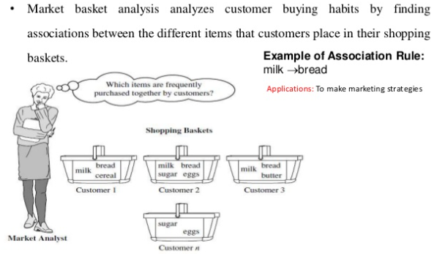
Market Basket Analysis

Slide 4
Basic Concepts: Frequent Patterns and Association Rules
Transaction-id | Items bought
10 | A, B, D
20 | A, C, D
30 | A, D, E
40 | B, E, F
50 | B, C, D, E, F
Itemset X = {x₁, …, x_{k}}
Find all the rules X → Y with minimum support and confidence
support, s, probability that a transaction contains X ∪ Y
confidence, c, conditional probability that a transaction having X also contains Y
Customer
buys both
Customer
buys diaper
Let sup_{min} = 50%, conf_{min} = 50%
Freq. Pat.: {A:3, B:3, D:4, E:3, AD:3}
Association rules:
A → D (60%, 100%)
D → A (60%, 75%)
Customer
buys beer

Slide 5
Some Definitions
Frequent Itemset
An itemset whose support count is greater than some user specified minimum support
Closed Frequent Itemset
An itemset is closed if none of its immediate supersets has the same support as that of the itemset
Maximal Frequent Itemset
An itemset is maximal frequent if none of its immediate superset is frequent

Slide 6
Some Definitions…
TID | List of Items
T1 | A, B, C, D
T2 | A, B, C, D
T3 | A, B, C
T4 | B, C, D
T5 | C, D
Example
Min_Sup = 3
Find Frequent, closed and maximal itemset
Item | Support
A, B | 3
A, C | 3
A, D | 2
B, C | 4
B, D | 3
C, D | 4
Item | Support
A | 3
B | 4
C | 5
D | 4

Slide 7
Association Rules
Example1: a female shopper buys a handbag is likely to buy shoes
Example2: when a male customer buys beer, he is likely to buy salted peanuts
We will represent an association rule in the following way:
MUSIC_MAG, HOUSE_MAG=>CAR_MAG
Somebody that reads both a music and a house magazine is also very likely to read a car magazine

Slide 8
Association Mining
Association rule mining:
Finding frequent patterns, associations, correlations, or causal structures among sets of items or objects in transaction databases, relational databases, and other information repositories.
Applications:
Basket data analysis, cross-marketing, catalog design, loss-leader analysis, clustering, classification, etc.
Examples.
Rule form: “Body → Ηead [support, confidence]”.
buys(x, “diapers”) → buys(x, “beers”) [0.5%, 60%]
major(x, “CS”) ^ takes(x, “DB”) → grade(x, “A”) [1%, 75%]

Slide 9
Association Rule Mining: A Road Map
Boolean vs. quantitative associations (Based on the types of values handled)
buys(x, “SQLServer”) ^ buys(x, “DMBook”) → buys(x, “DBMiner”) [0.2%, 60%]
age(x, “30..39”) ^ income(x, “42..48K”) → buys(x, “PC”) [1%, 75%]
Single dimension vs. multiple dimensional associations (each distinct predicate of a rule is a dimension)
Single level vs. multiple-level analysis (consider multiple levels of abstraction)
What brands of beers are associated with what brands of diapers?

Slide 10
Apriori: A Candidate Generation-and-Test Approach
Apriori pruning principle: If there is any itemset which is infrequent, its superset should not be generated/tested!
Method:
Initially, scan DB once to get frequent 1-itemset
Generate length (k+1) candidate itemsets from length k frequent itemsets
Test the candidates against DB
Terminate when no frequent or candidate set can be generated

Slide 11
The Apriori Algorithm
Pseudo-code:
C_{k}: Candidate itemset of size k
L_{k} : frequent itemset of size k
L₁ = {frequent items};
for (k = 1; L_{k} !=∅; k++) do begin
C_{k+1} = candidates generated from L_{k};
for each transaction t in database do
increment the count of all candidates in C_{k+1} that are contained in t
L_{k+1} = candidates in C_{k+1} with min_support
end
return ∪_{k} L_{k};

Slide 12
The Apriori Algorithm
Begin
Initialise the candidate Item-sets as single items in database.
Scan the database and count the frequency of the candidate item-sets, then Large Item-sets are decided based on the user specified min_sup.
Any new Large
Item-sets?
NO
YES
Based on the Large Item-sets, expand them with one more item to generate new Candidate item-sets.
Stop

Slide 13
Apriori: A Candidate Generation-and-test Approach
Any subset of a frequent itemset must be frequent
if {beer, diaper, nuts} is frequent, so is {beer, diaper}
Every transaction having {beer, diaper, nuts} also contains {beer, diaper}
Apriori pruning principle: If there is any itemset which is infrequent, its superset should not be generated/tested!

Slide 14
The Apriori Algorithm—An Example
Sup_{min} = 2
Itemset | sup
{A} | 2
{B} | 3
{C} | 3
{D} | 1
{E} | 3
Database TDB
Itemset | sup
{A} | 2
{B} | 3
{C} | 3
{E} | 3
L₁
Tid | Items
10 | A, C, D
20 | B, C, E
30 | A, B, C, E
40 | B, E
C₁
1st scan
C₂
Itemset | sup
{A, B} | 1
{A, C} | 2
{A, E} | 1
{B, C} | 2
{B, E} | 3
{C, E} | 2
C₂
Itemset
{A, B}
{A, C}
{A, E}
{B, C}
{B, E}
{C, E}
L₂
Itemset | sup
{A, C} | 2
{B, C} | 2
{B, E} | 3
{C, E} | 2
2nd scan
C₃
Itemset
{B, C, E}
3rd scan
L₃
Itemset | sup
{B, C, E} | 2

Slide 15


The Apriori Algorithm—An Example …
Tid | Items
10 | A, C, D
20 | B, C, E
30 | A, B, C, E
40 | B, E
Rules (Minimum Confidence = 75%)
Conf(A→B) = (A ∪ B) / A
Now
B → C × E :Confidence = 2/3 = 66%
C → B × E :Confidence = 2/3 = 66%
E → B × C :Confidence = 2/3 = 66%
C × E → B :Confidence = 2/2 = 100%
B × E → C :Confidence = 2/3 = 66%
B × C → E :Confidence = 2/2 = 100%

Slide 16
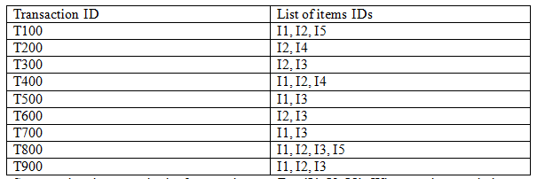
The Apriori Algorithm—An Exercise
Minimum Support = 2
Minimum Confidence = 75%

Slide 17
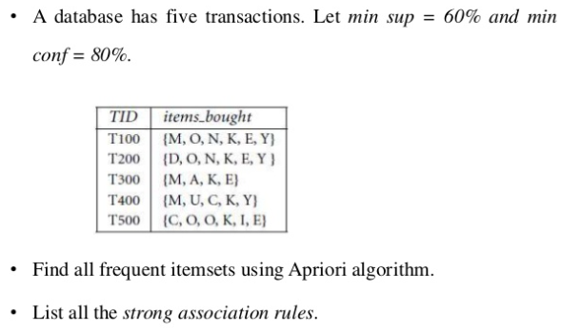
The Apriori Algorithm—An Exercise

Slide 18
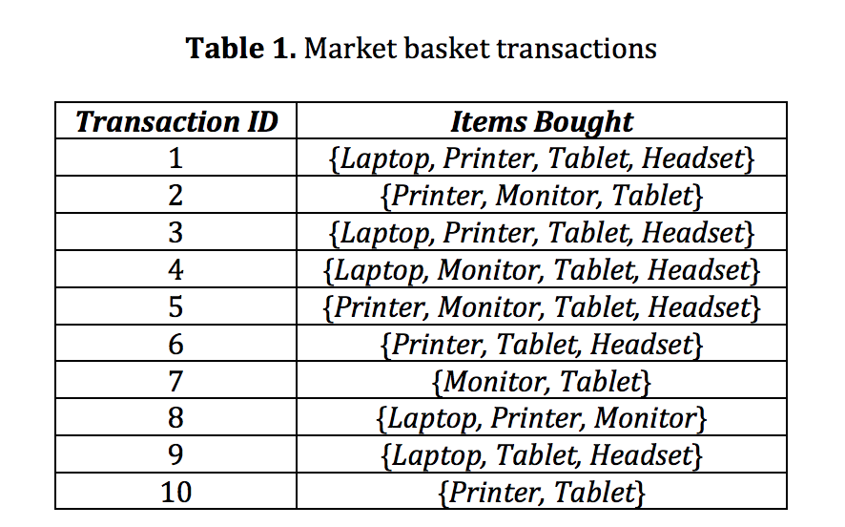
The Apriori Algorithm—An Exercise

Slide 19
Mining Multilevel Association
Items often form hierarchies
Association rules generated from mining data at multiple levels of abstraction are called multiple-level or multilevel association rules
Using uniform minimum support for all levels
Using reduced minimum support at lower levels
uniform support
reduced support
Level 1
min_sup = 5%
Milk
[support = 10%]
Level 1
min_sup = 5%
Level 2
min_sup = 5%
DDC Milk
[support = 6%]
ND Milk
[support = 4%]
Level 2
min_sup = 3%

Slide 20
Mining Multi-Dimensional Association
Single-dimensional rules:
buys(X, “milk”) ⇒ buys(X, “bread”)
Multi-dimensional rules: ≥ 2 dimensions or predicates
Inter-dimension assoc. rules (no repeated predicates)
age(X,”19-25”) ∧ occupation(X,“student”) ⇒ buys(X, “coke”)
hybrid-dimension assoc. rules (repeated predicates)
age(X,”19-25”) ∧ buys(X, “popcorn”) ⇒ buys(X, “coke”)

Slide 21
Problems with A-priori Algorithms
It is costly to handle a huge number of candidate sets. For example if there are 10⁴ large 1-itemsets, the Apriori algorithm will need to generate more than 10⁷ candidate 2-itemsets. Moreover for 100-itemsets, it must generate more than 2¹⁰⁰ ≈ 10³⁰ candidates in total.
When Database is scanned to check Ck for creating Lk, a large number of transactions will be scanned even they do not contain any k-itemset.

Slide 22
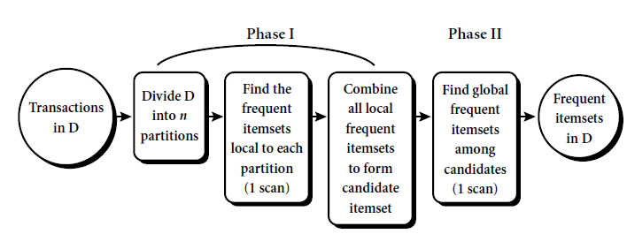
Some techniques to improve perfomance of Apriori
Transaction reduction
Any transaction without k-itemset is not necessary to be involved in next scan
Sampling
Reduce the load
Partitioning

Slide 23
Mining Frequent Itemsets without Candidate Generation
FP-Growth (Frequent Pattern Growth)
FP growth algorithm used for finding frequent itemset in a transaction database without candidate generation
Method for mining the complete set of frequent patterns by pattern fragment growth, using an extended prefix-tree structure for storing compressed and crucial information about frequent patterns named frequent-pattern tree (FP-tree)

Slide 24
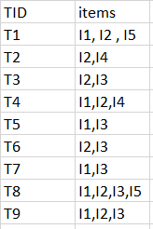

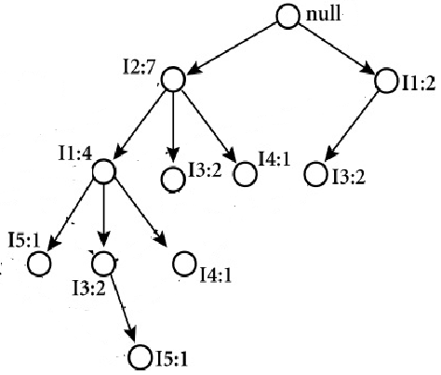
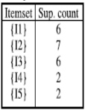
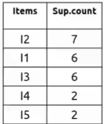
FP Growth (Example)
FP Tree Construction
4
2
3
null
2
I2:1
I4:1
I3:1
Minimum Support = 2
I1:1
Sort
I2,I1,I5
I5:1
I4:1
I2, I4
I2, I3
I2,I1,I4
L1
Sort in
descending
order

Slide 25
From Association Mining to Correlation Analysis
Most association rule mining algorithms employ a support-confidence framework
Strong Rules Are Not Necessarily Interesting
Example
Let game refer to the transactions containing computer games, and video refer to those containing videos. Of the 10,000 transactions analyzed, the data show that 6,000 of the customer transactions included computer games, while 7,500 included videos, and 4,000 included both computer games and videos
Using a minimum support of, say, 30% and a minimum confidence of 60%. The following association rule is discovered
buys(X, “computer games”) → buys(X, “videos”) [support = 40%, confidence = 66%]
is misleading because the probability of purchasing videos is 75%, which is even larger than 66%
In fact, computer games and videos are negatively associated because the purchase of one of these items actually decreases the likelihood of purchasing the other

Slide 26
From Association Mining to Correlation Analysis…
To tackle this weakness, a correlation measure can be used to augment the support-confidence framework for association rules
This leads to correlation rules of the form
A → B [support, confidence. correlation].
That is, a correlation rule is measured not only by its support and confidence but also by the correlation between itemsets A and B
There are many different correlation measures from which to choose
Lift

Slide 27
Lift
The occurrence of itemset A is independent of the occurrence of itemset B if P(A ∪ B) = P(A)P(B)
otherwise, itemsets A and B are dependent and correlated as events
If the value is less than 1, then the occurrence of A is negatively correlated with the occurrence of B. If the resulting value is greater than 1, then A and B are positively correlated, meaning that the occurrence of one implies the occurrence of the other. If the resulting value is equal to 1, then A and B are independent and there is no correlation between them

Slide 28
Lift...
play basketball ⇒ eat cereal [40%, 66.7%] is misleading
The overall % of students eating cereal is 75% > 66.7%.
play basketball ⇒ not eat cereal [20%, 33.3%] is more accurate, although with lower support and confidence
Measure of dependent/correlated events: lift
 | Basketball | Not basketball | Sum (row)
Cereal | 2000 | 1750 | 3750
Not cereal | 1000 | 250 | 1250
Sum(col.) | 3000 | 2000 | 5000

Slide 29
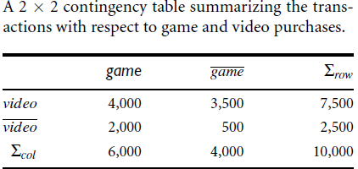
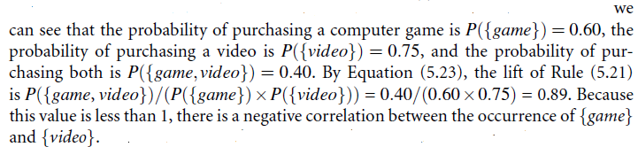
Lift...

Slide 30
End of Session

